Slide 1
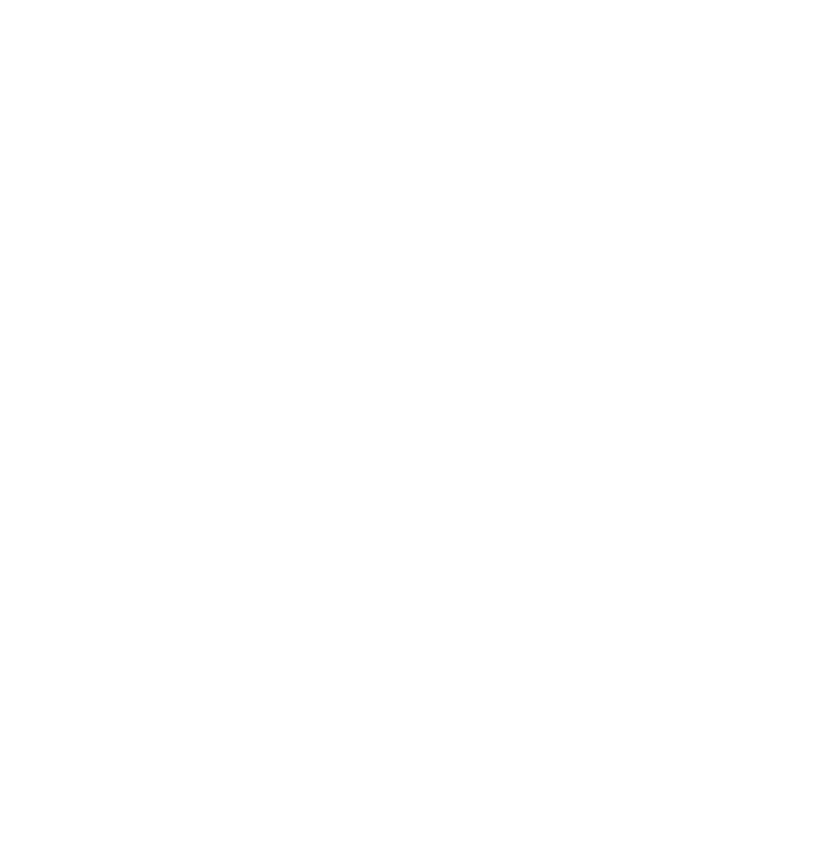
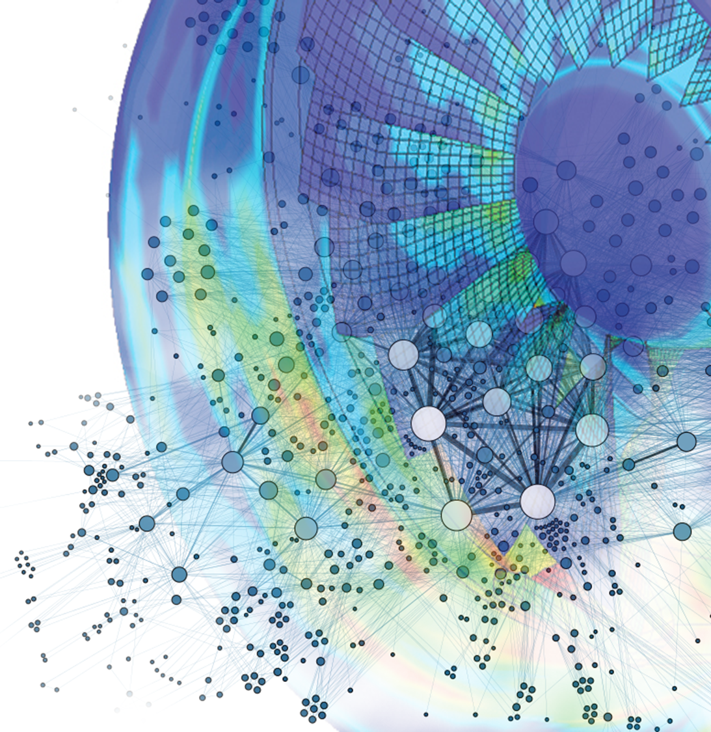

GT2021-65169
Tutorial of basics
On surrogate-based optimization of truly reversible blade profiles for axial fans
Alessandro Corsini, Giovanni Delibra, Lorenzo Tieghi and Francesco Aldo Tucci
Sapienza University of Rome,
Department of Mechanical and Aerospace Engineering
ASME Turbo Expo 2021
Turbomachinery Technical Conference and Exposition
June 7 – 11, Virtual, Online

Slide 2
Outline
Basics elements of neural networks
Neural network – Live tutorial
Neural network in turbomachinery design
Q&A
Notes:
Today we will show you the basics to understand Neural networks and how these can be applied to turbomachinery problems.
The first part of the tutorial is a brief introduction to neural networks which explains what their basic elements are and how they work. Then, I will leave the floor to my colleague Lorenzo and he will perform a live demonstration of programming a Neural Network. At the end of this tutorial you will learn how to program a neural network, you will understand a bit of exploratory data analysis and how you can possibly include a ML approach in your engineering problem solving.

Slide 3
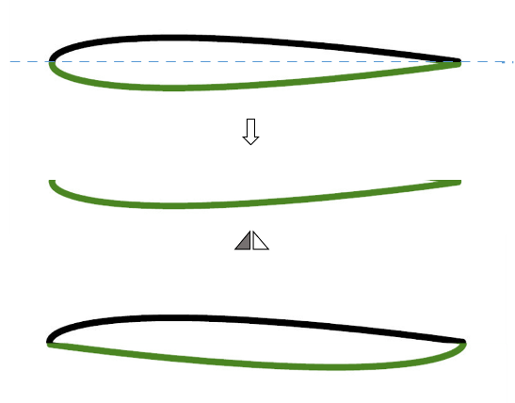
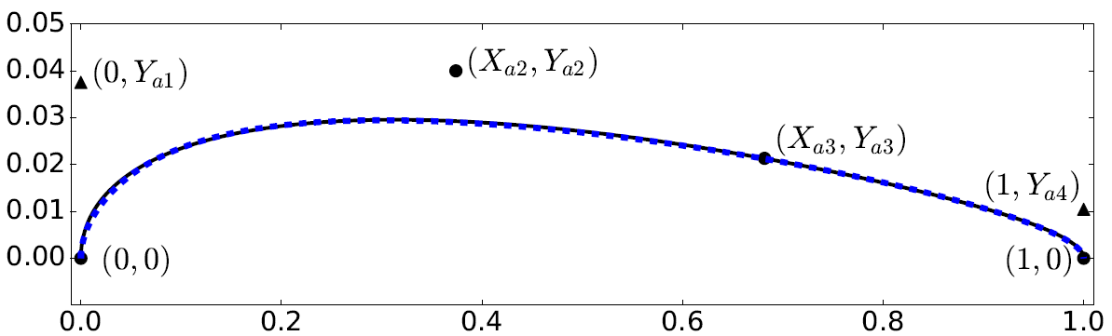
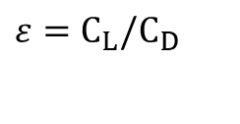
Goals & Methods
This work presents a study on the surrogate model-based methodology (SM) to obtain a set of optimized airfoils for reversible fans
Research questions:
How meta-model techniques affect results of multi objectives optimization?
How these meta-models should be exploited in an optimization process?
Objective functions:
Aerodynamic efficiency
Stall margin
$$ε=C_{L}/C_{D}$$
Geometry parameterization:
6th degree B-spline
Truly reversible airfoil: generation (top) and 6th degree spline (bottom)
Notes:
The aim of the tutorial is to provide the audience the basis to understand Neural networks, and how these can be applied to turbomachinery problems.
The first part of the tutorial provides a brief introduction to neural networks which explains what their basic elements are and how they work. Then, I will leave the floor to my colleague Dr Lorenzo Tieghi and he will discuss the use of neural network to engineering problems focusing on how to model aerodynamic performances of a cascade using neural network.

Slide 4
Optimization algorithm
Non-dominated sorting genetic algorithm (NSGA-II), Deb et al. 2012
NSGA-II combines non-dominated sorting with a diversity-preserving mechanism based on crowding distance
A matrix of 25 optimization cases representing common operations for tunnel and metro fans was defined by means of combinations of 5 Re values and 5 C_{LS} values
The final design space includes 8 parameters:
Test matrix definition
Re | 300000 | 675000 | 1050000 | 1425000 | 1800000
C_{LS} | 0.1 | 0.3 | 0.5 | 0.7 | 0.9
Notes:
The aim of the tutorial is to provide the audience the basis to understand Neural networks, and how these can be applied to turbomachinery problems.
The first part of the tutorial provides a brief introduction to neural networks which explains what their basic elements are and how they work. Then, I will leave the floor to my colleague Dr Lorenzo Tieghi and he will discuss the use of neural network to engineering problems focusing on how to model aerodynamic performances of a cascade using neural network.

Slide 5
Optimization framework
Optimizer: NSGA-II
XFoil (MOEA)
Design space
Initial Population:
40 reversible aerofoils
SM : LSM, ANN
Single level framework
Target operations
Test Functions
SM : LSM, ANN
Bi- level framework
Optimizer
Extended Population
10 generations
XFoil was used as test function in the standard optimization.
To reduce the computational effort, a LSM and ANN meta-models were developed
Optimized
Airfoils
Non dominated sorting + Crowding distance = Pareto Front
Next generation
Notes:
The aim of the tutorial is to provide the audience the basis to understand Neural networks, and how these can be applied to turbomachinery problems.
The first part of the tutorial provides a brief introduction to neural networks which explains what their basic elements are and how they work. Then, I will leave the floor to my colleague Dr Lorenzo Tieghi and he will discuss the use of neural network to engineering problems focusing on how to model aerodynamic performances of a cascade using neural network.

Slide 6
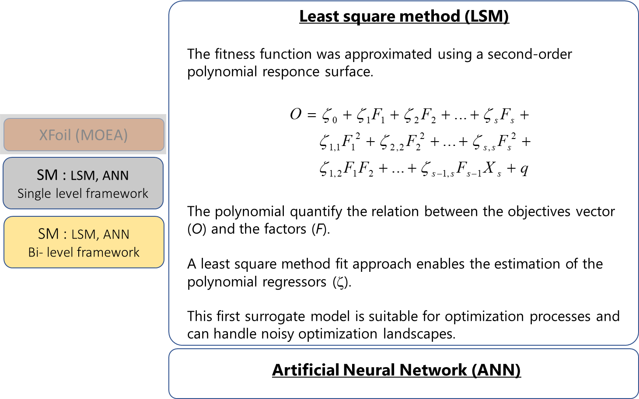
Surrogate models
Notes:
The aim of the tutorial is to provide the audience the basis to understand Neural networks, and how these can be applied to turbomachinery problems.
The first part of the tutorial provides a brief introduction to neural networks which explains what their basic elements are and how they work. Then, I will leave the floor to my colleague Dr Lorenzo Tieghi and he will discuss the use of neural network to engineering problems focusing on how to model aerodynamic performances of a cascade using neural network.

Slide 7
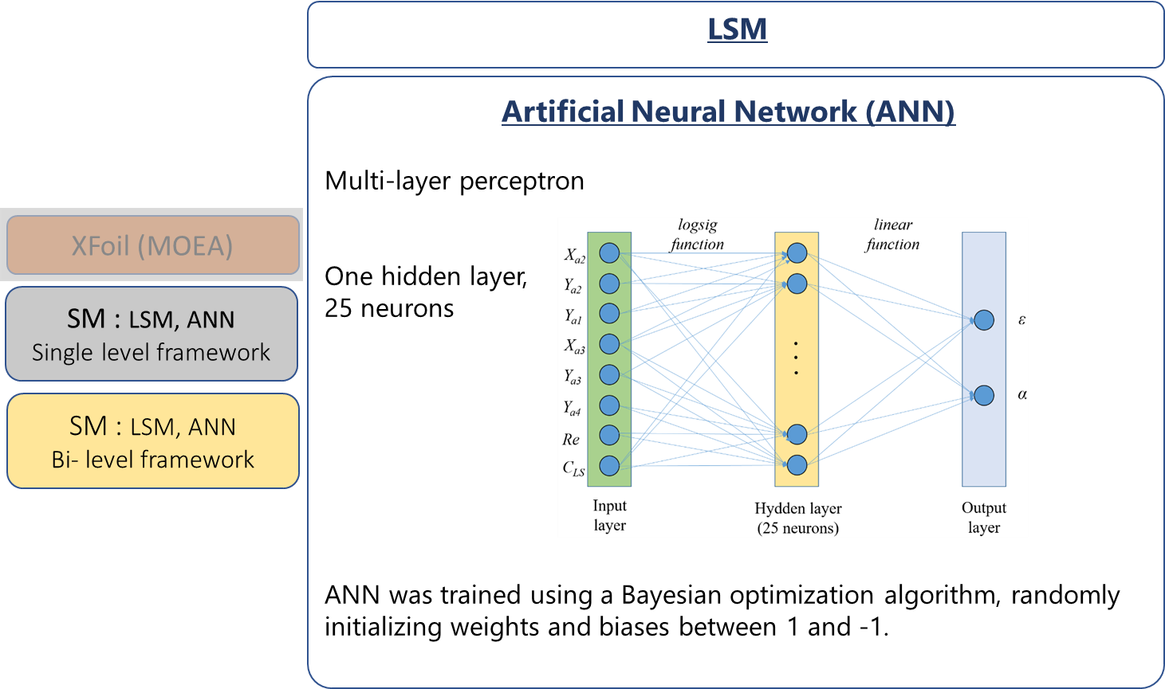
Surrogate models
Notes:
The aim of the tutorial is to provide the audience the basis to understand Neural networks, and how these can be applied to turbomachinery problems.
The first part of the tutorial provides a brief introduction to neural networks which explains what their basic elements are and how they work. Then, I will leave the floor to my colleague Dr Lorenzo Tieghi and he will discuss the use of neural network to engineering problems focusing on how to model aerodynamic performances of a cascade using neural network.

Slide 8
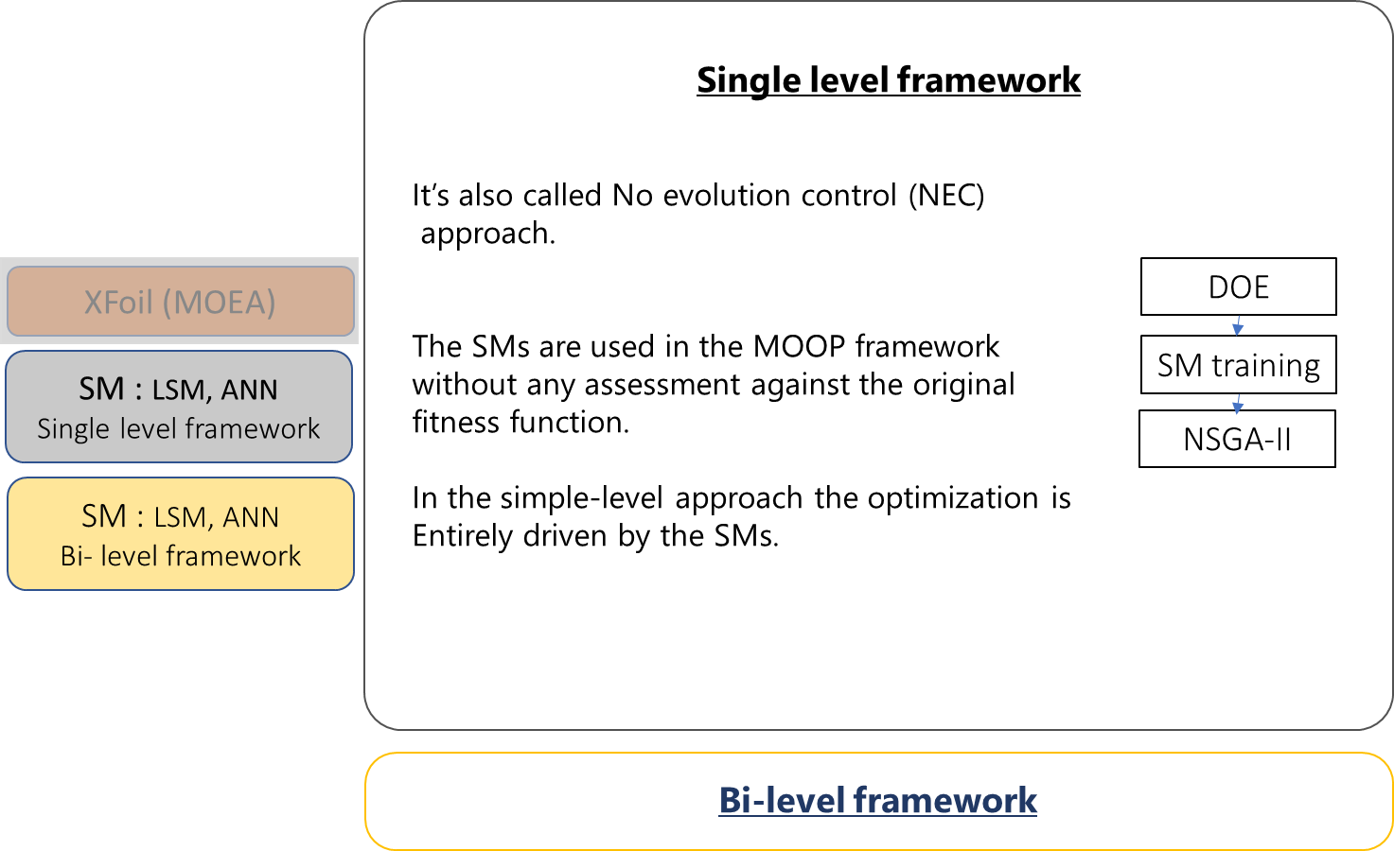
SMs framework
Notes:
The aim of the tutorial is to provide the audience the basis to understand Neural networks, and how these can be applied to turbomachinery problems.
The first part of the tutorial provides a brief introduction to neural networks which explains what their basic elements are and how they work. Then, I will leave the floor to my colleague Dr Lorenzo Tieghi and he will discuss the use of neural network to engineering problems focusing on how to model aerodynamic performances of a cascade using neural network.

Slide 9
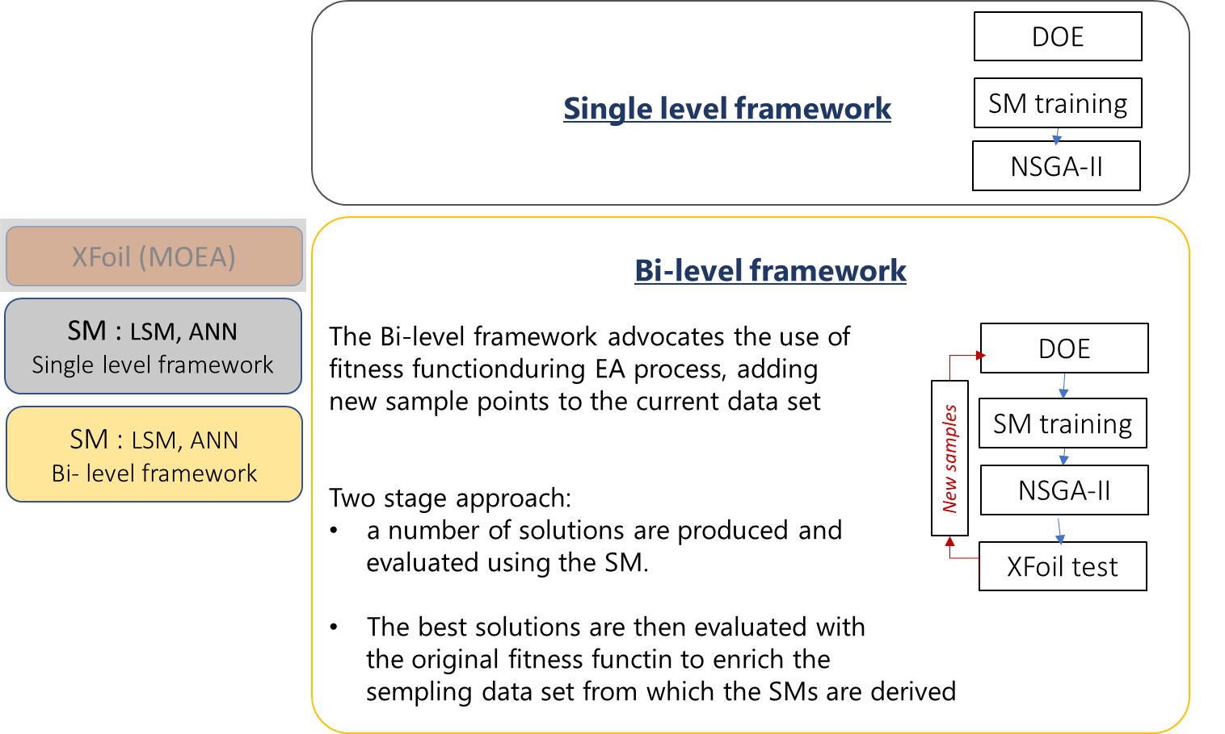
Surrogate models
Notes:
The aim of the tutorial is to provide the audience the basis to understand Neural networks, and how these can be applied to turbomachinery problems.
The first part of the tutorial provides a brief introduction to neural networks which explains what their basic elements are and how they work. Then, I will leave the floor to my colleague Dr Lorenzo Tieghi and he will discuss the use of neural network to engineering problems focusing on how to model aerodynamic performances of a cascade using neural network.

Slide 10
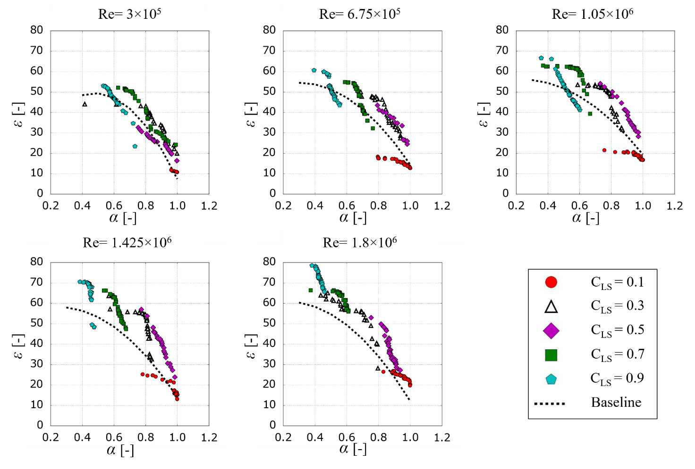
MOEA results
The standard MOEA results are illustrated. The selected objective function was based on XFoil.
The dotted line is the initial frontier. The optimization technique should move this imaginary frontier toward higher efficiencies and stall margins.
The results for all Re and C_{LS} combinations of the text matrix after 10 generations are shown.
Notes:
The aim of the tutorial is to provide the audience the basis to understand Neural networks, and how these can be applied to turbomachinery problems.
The first part of the tutorial provides a brief introduction to neural networks which explains what their basic elements are and how they work. Then, I will leave the floor to my colleague Dr Lorenzo Tieghi and he will discuss the use of neural network to engineering problems focusing on how to model aerodynamic performances of a cascade using neural network.

Slide 11
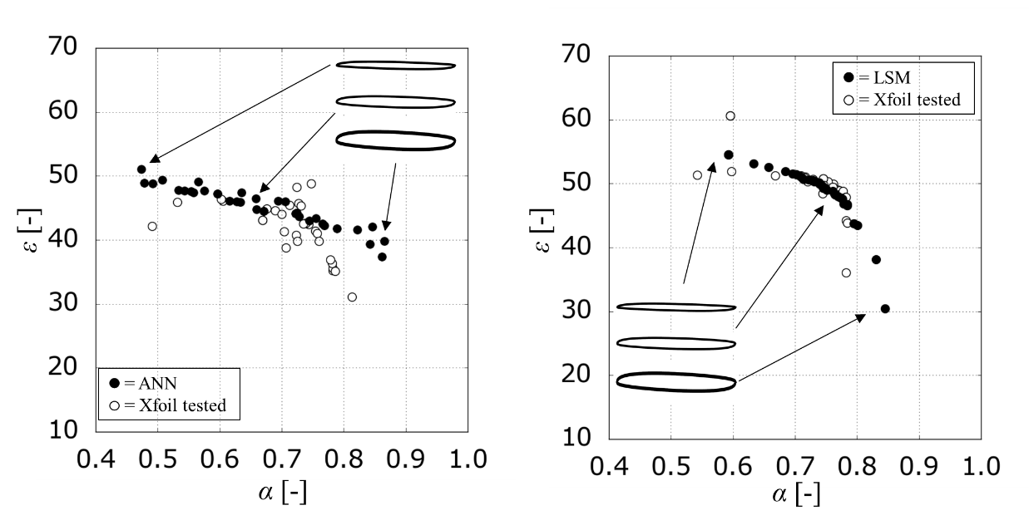
SM-based optimization
The figure shows the results of the final iteration loop for the combination Re=1.05×106, C_{LS}=0.5.
In the bi-level approach, irrespective to the SM used, aerodynamic performance predictions are in good agreement with XFoil predictions.
Notes:
The aim of the tutorial is to provide the audience the basis to understand Neural networks, and how these can be applied to turbomachinery problems.
The first part of the tutorial provides a brief introduction to neural networks which explains what their basic elements are and how they work. Then, I will leave the floor to my colleague Dr Lorenzo Tieghi and he will discuss the use of neural network to engineering problems focusing on how to model aerodynamic performances of a cascade using neural network.

Slide 12
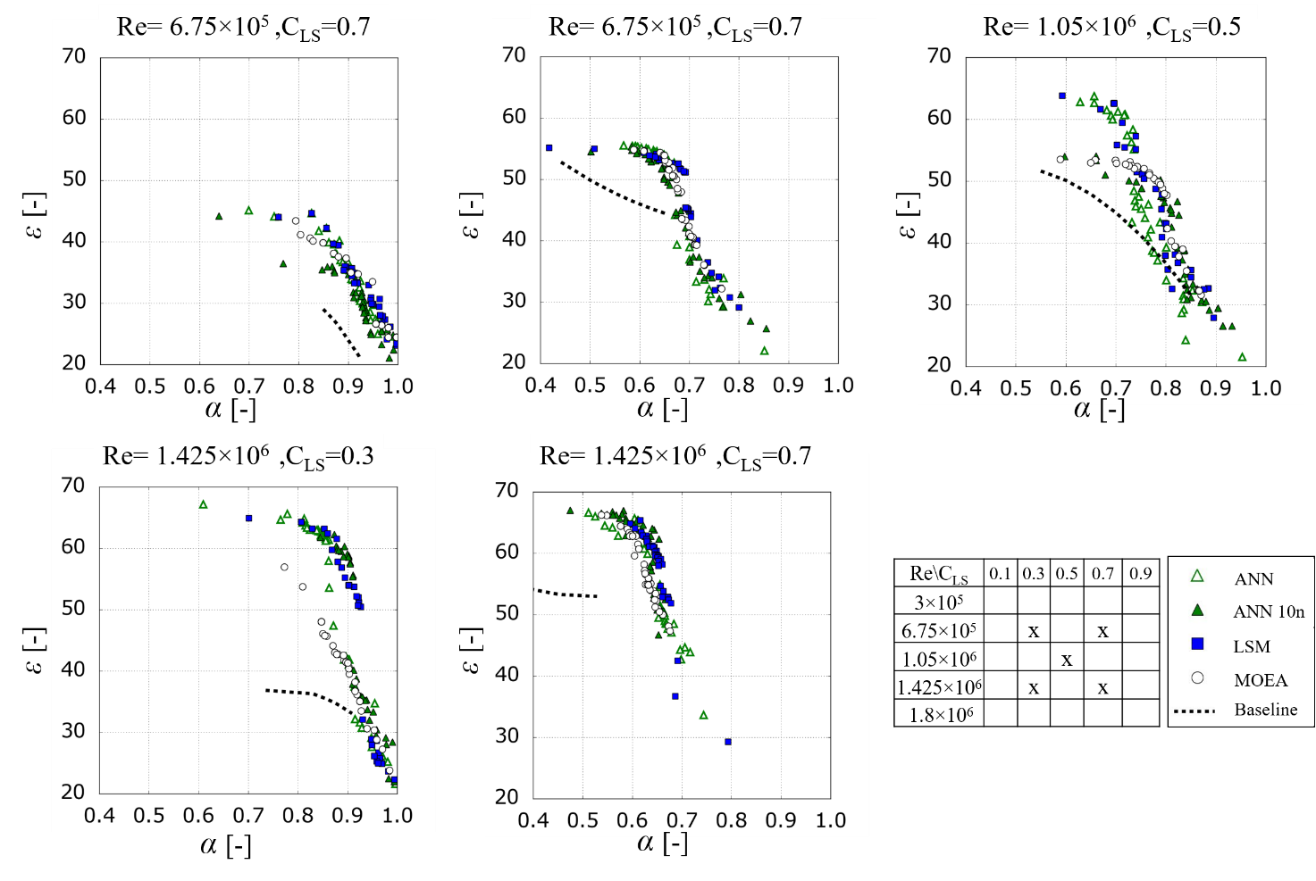
SM-based optimization results
These results give at a glance the indication of the quality of SMs assisted optimization implemented in the Bi-level test-bed, using half of the computational effort required by the standard one.
Notes:
The aim of the tutorial is to provide the audience the basis to understand Neural networks, and how these can be applied to turbomachinery problems.
The first part of the tutorial provides a brief introduction to neural networks which explains what their basic elements are and how they work. Then, I will leave the floor to my colleague Dr Lorenzo Tieghi and he will discuss the use of neural network to engineering problems focusing on how to model aerodynamic performances of a cascade using neural network.

Slide 13
SM-based optimization results
These results give at a glance the indication of the quality of SMs assisted optimization implemented in the Bi-level test-bed, using half of the computational effort required by the standard one.
Notes:
The aim of the tutorial is to provide the audience the basis to understand Neural networks, and how these can be applied to turbomachinery problems.
The first part of the tutorial provides a brief introduction to neural networks which explains what their basic elements are and how they work. Then, I will leave the floor to my colleague Dr Lorenzo Tieghi and he will discuss the use of neural network to engineering problems focusing on how to model aerodynamic performances of a cascade using neural network.

Slide 14
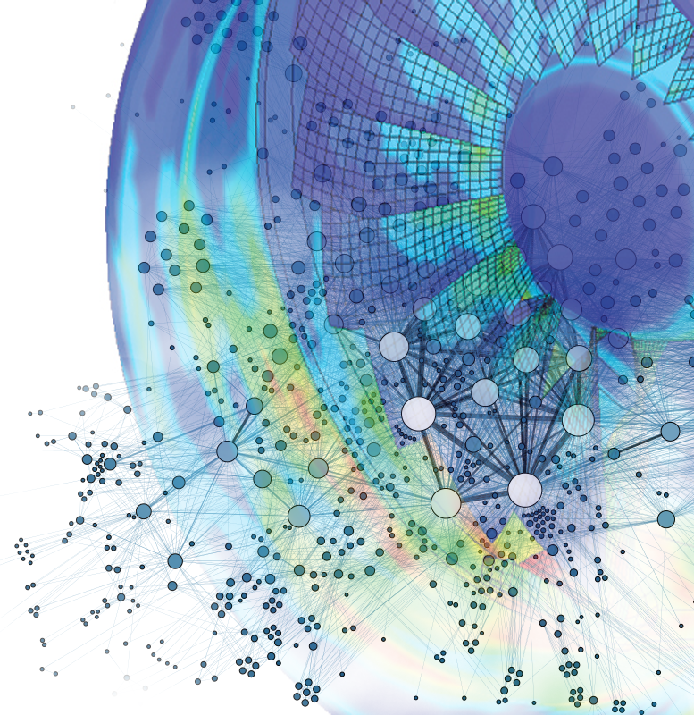

Are you interested in this topic? Learn more later today
GT2021-59227
Cascade with Sinusoidal Leading Edges: Identification and Quantification of Deflection with Unsupervised Machine Learning
Alessandro Corsini, Giovanni Delibra, Lorenzo Tieghi and Francesco Aldo Tucci
Session 10-03: CFD and Machine Learning for Fans and Blowers
Today 4:00 pm - 5:30 pm
Notes:
Hello everyone and welcome to this virtual presentation for the FANS AND BLOWERS Session. I’m Francesco Aldo Tucci, from Sapienza University of Rome. Today we will discuss about the identification and quantification of deflection with unsupervised machine learning for a cascade characterized by sinusoidal leading edges. But before we start, I would like to thank my co-authors: Professor Alessandro Corsini, Doctor Giovanni Delibra and Doctor Lorenzo Tieghi.

Slide 15
Are you interested in this topic? Learn more later today
GT2021-59227
Cascade with Sinusoidal Leading Edges: Identification and Quantification of Deflection with Unsupervised Machine Learning
Alessandro Corsini, Giovanni Delibra, Lorenzo Tieghi and Francesco Aldo Tucci
Session 10-03: CFD and Machine Learning for Fans and Blowers
Today 4:00 pm - 5:30 pm
THANK YOU
Notes:
Hello everyone and welcome to this virtual presentation for the FANS AND BLOWERS Session. I’m Francesco Aldo Tucci, from Sapienza University of Rome. Today we will discuss about the identification and quantification of deflection with unsupervised machine learning for a cascade characterized by sinusoidal leading edges. But before we start, I would like to thank my co-authors: Professor Alessandro Corsini, Doctor Giovanni Delibra and Doctor Lorenzo Tieghi.

